Slide 1
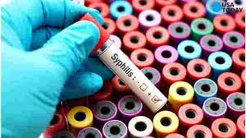
Syphilis Is On the Rise
Name
Institution of affiliation

Slide 2
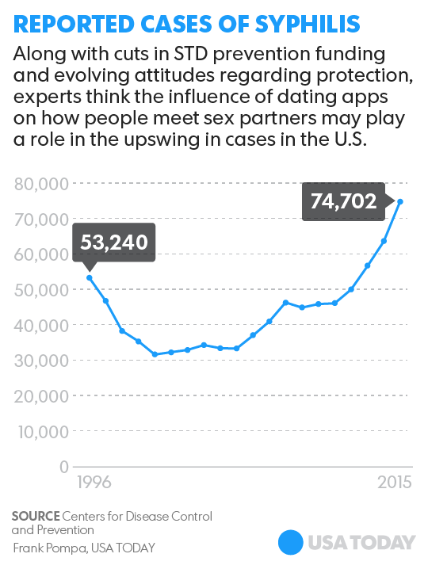
Introduction
Cases of syphilis have increased in the last 2 decades based on the CDC report of STD surveillance.
There are many reasons for the increased case reports which has been suggested.
The main reasons include changes in dating patterns, varied sexual relations and funding shortage of the particular STD.
Syphilis being viewed as an ancient condition is also a factor to be considered.

Slide 3
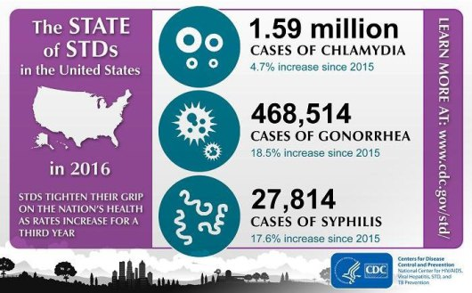
Changes In Dating Patterns
This is the major factor that has let to an increase in the number of people having syphilis in the general population
The dating sites and apps is actually the driving factor that has let to an increase in the syphilis cases
The people do not have a good history of their partners before they engage in sexual activities.
Furthermore, syphilis is a condition that one may not suspect their partners they have because in most cases it is asymptomatic.

Slide 4

Varied Sexual Relations
In the modern society, gay relations have been on rise which is a major risk factor for STD spread.
In fact, majority of the cases reported about syphilis were among the partners who were in the gay relationship.
Of note is the men of have sex with men relations which recorded the highest number syphilis cases according to the CDC report.

Slide 5
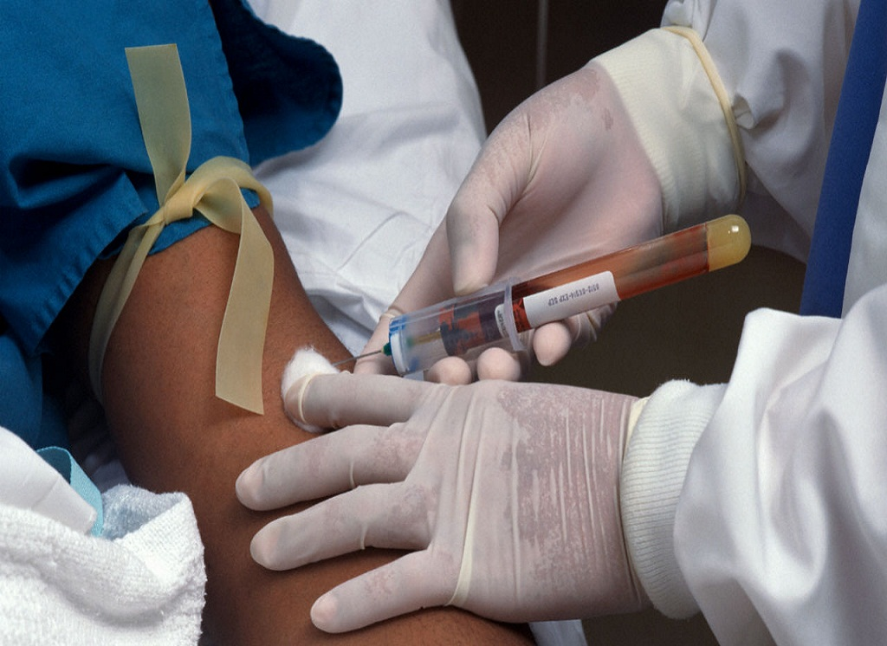
Funding And Prevention
Funding for the elimination of the syphilis condition has been on the decrease in most states across the country.
This has let to a decrease in the number of health workers and institutions providing healthcare services related to syphilis.
It is therefore important to increase funding in order to address the increased rising cases of STDs and in particular syphilis.

